Slide 1
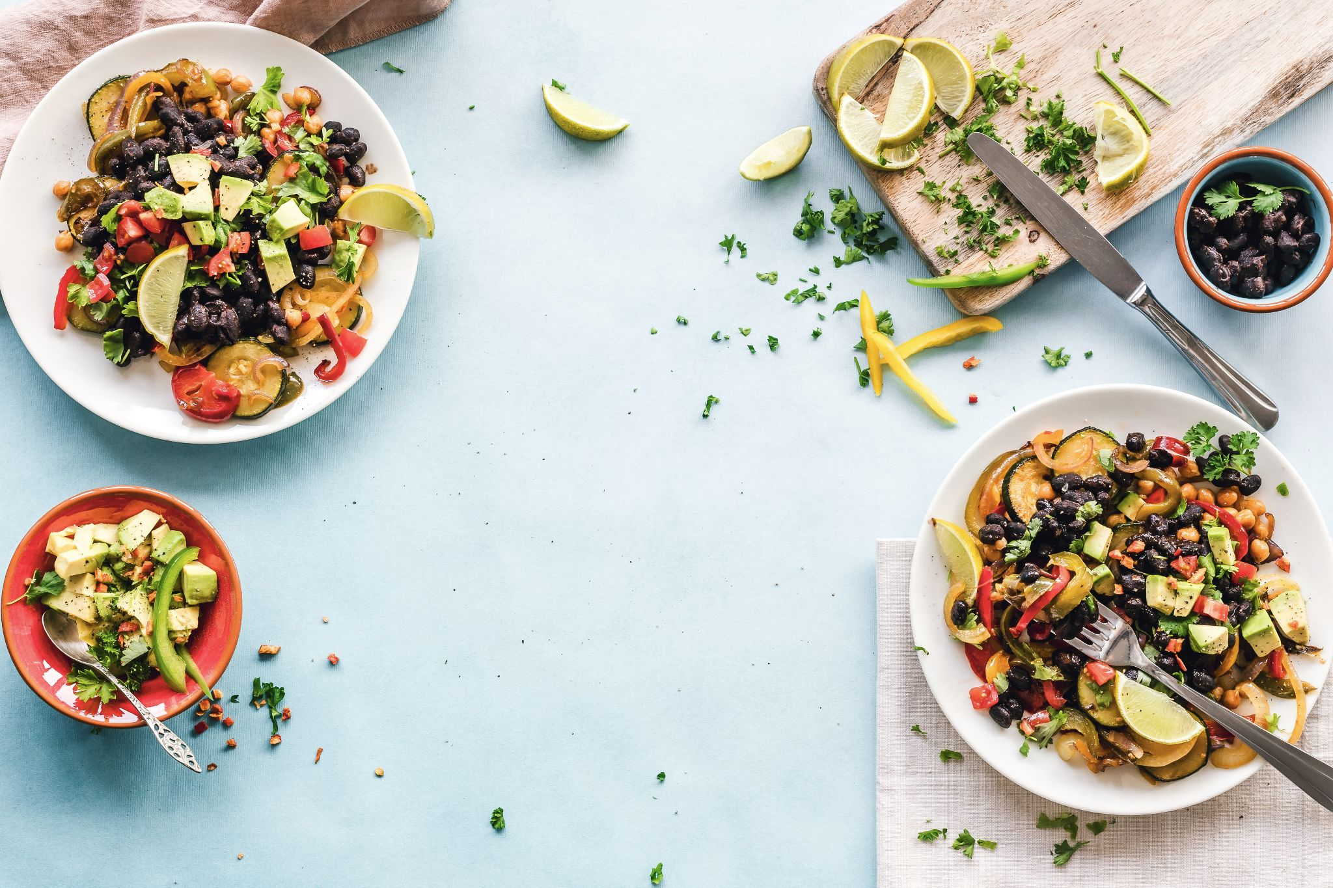

Gordo Bot
Team 6:
Zachary Laguna
Raney Ankele
Reid Morse
Cody Nguyen
Thomas Rod
Nicholas Soliman
Photo by Ella Olsson on Unsplash

Slide 2
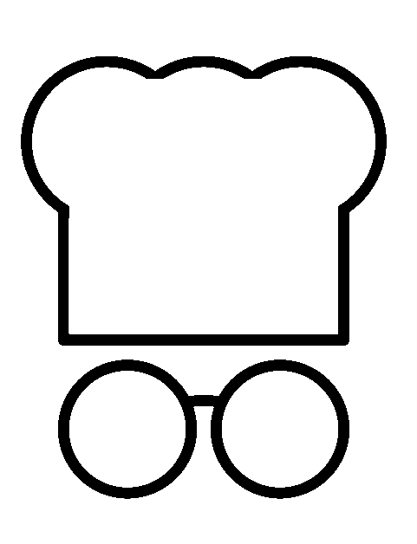
Overview
Introduction
Problem Statement
Requirements
Design
Proposed Solutions
Chosen solution
Design Constraints
System Description
Component Descriptions
Environmental and Health Concerns
Manufacturability, Sustainability, and Economics
Social, Political, and Ethical Concerns
Demonstration
Q/A
Notes:
Jake

Slide 3
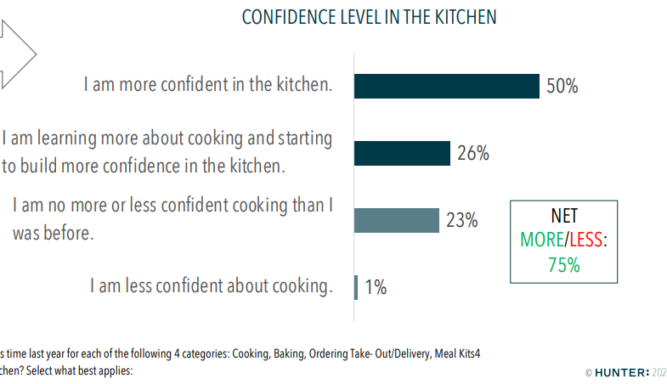
Problem Statement
Cooking at home has become more appealing due to the following:
Covid
Healthier alternative
Less expensive
But amateur cooks may find it difficult to start
We want to make cooking at home easier for new cooks
How can we make cooking more appealing to new cooks?
How can we make cooking easier on cooks that struggle following complicated recipes?
How can we make measuring ingredients easier?
Notes:
Jake

Slide 4
Requirements
The device should reduce the complication of cooking
The device should ease the process of recipe tracking
The device should be compact enough to use in the kitchen
Device utilization should be readily apparent
Notes:
Nick

Slide 5
Proposed Solutions
Buy some combination of existing products
Simpler functions
Separate pieces
Lacks automation and smart functions
Rate of Flow tool
Smart tool attachment determines when to stop based on calculations from flow rate
Less smart functions
High possibility of unforeseen error in design
Speech Recognition Adjustable
Smart tool improvement on existing product
Not as smart as desired for our product
Kitchen All-In-One
Includes wide variety of features
Useful, but scope could be too large
Notes:
Reid

Slide 6
Chosen Solution
Kitchen helper bot
Gives instructions to user
Measures out stored ingredients
Stores and tracks recipes through web app
Some previous ideas incorporated
Scale to determine amount of ingredient dispensed
Pump to dispense liquid ingredients
Servo to turn a wheel of ingredients
Portions of kitchen all-in-one
Recipe tracking
Notes:
Zach

Slide 7
Design Constraints & Feasibility
Need to account for the difference between solid and liquid ingredients
Accuracy of sensors could affect recipes
Device should be the size of the average kitchen appliance due to limited counter space
Needs to be affordable
Hardware speed and computing have a inevitable overhead
May be a challenge to properly power all components
Recipes will be entered by the users
Web app to interfaces with devices
Time frame determines stretch goals
Notes:
Raney

Slide 8
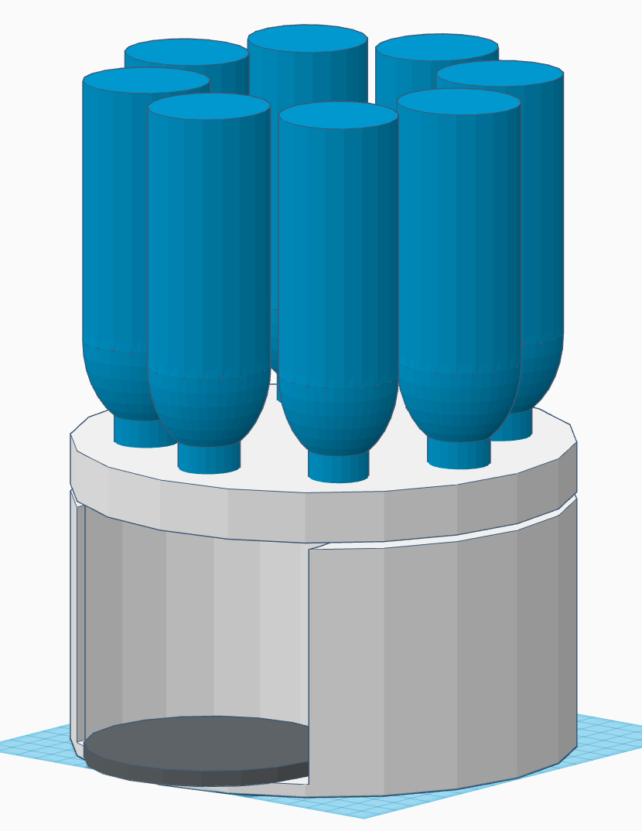
Prototyped Design
The prototyped design had ways to improve:
Top heavy due to the shape and height of the compartments.
Individual flow sensor/valves and servos for each ingredient compartment was found to be not cost effective.
Completely separated compartments made cleaning, storage, and attachment to device more complicated
Notes:
Cody
Easier to use individual flow sensors rather than trying to use one flow sensor and switch ingredients
Also less messy and less cross contamination between ingredients
- Scoop / water wheel like design inside to move ingredients out in a relatively controlled manner
- Individual parts 3D-printed and prototyped before proceeding with the next parts

Slide 9
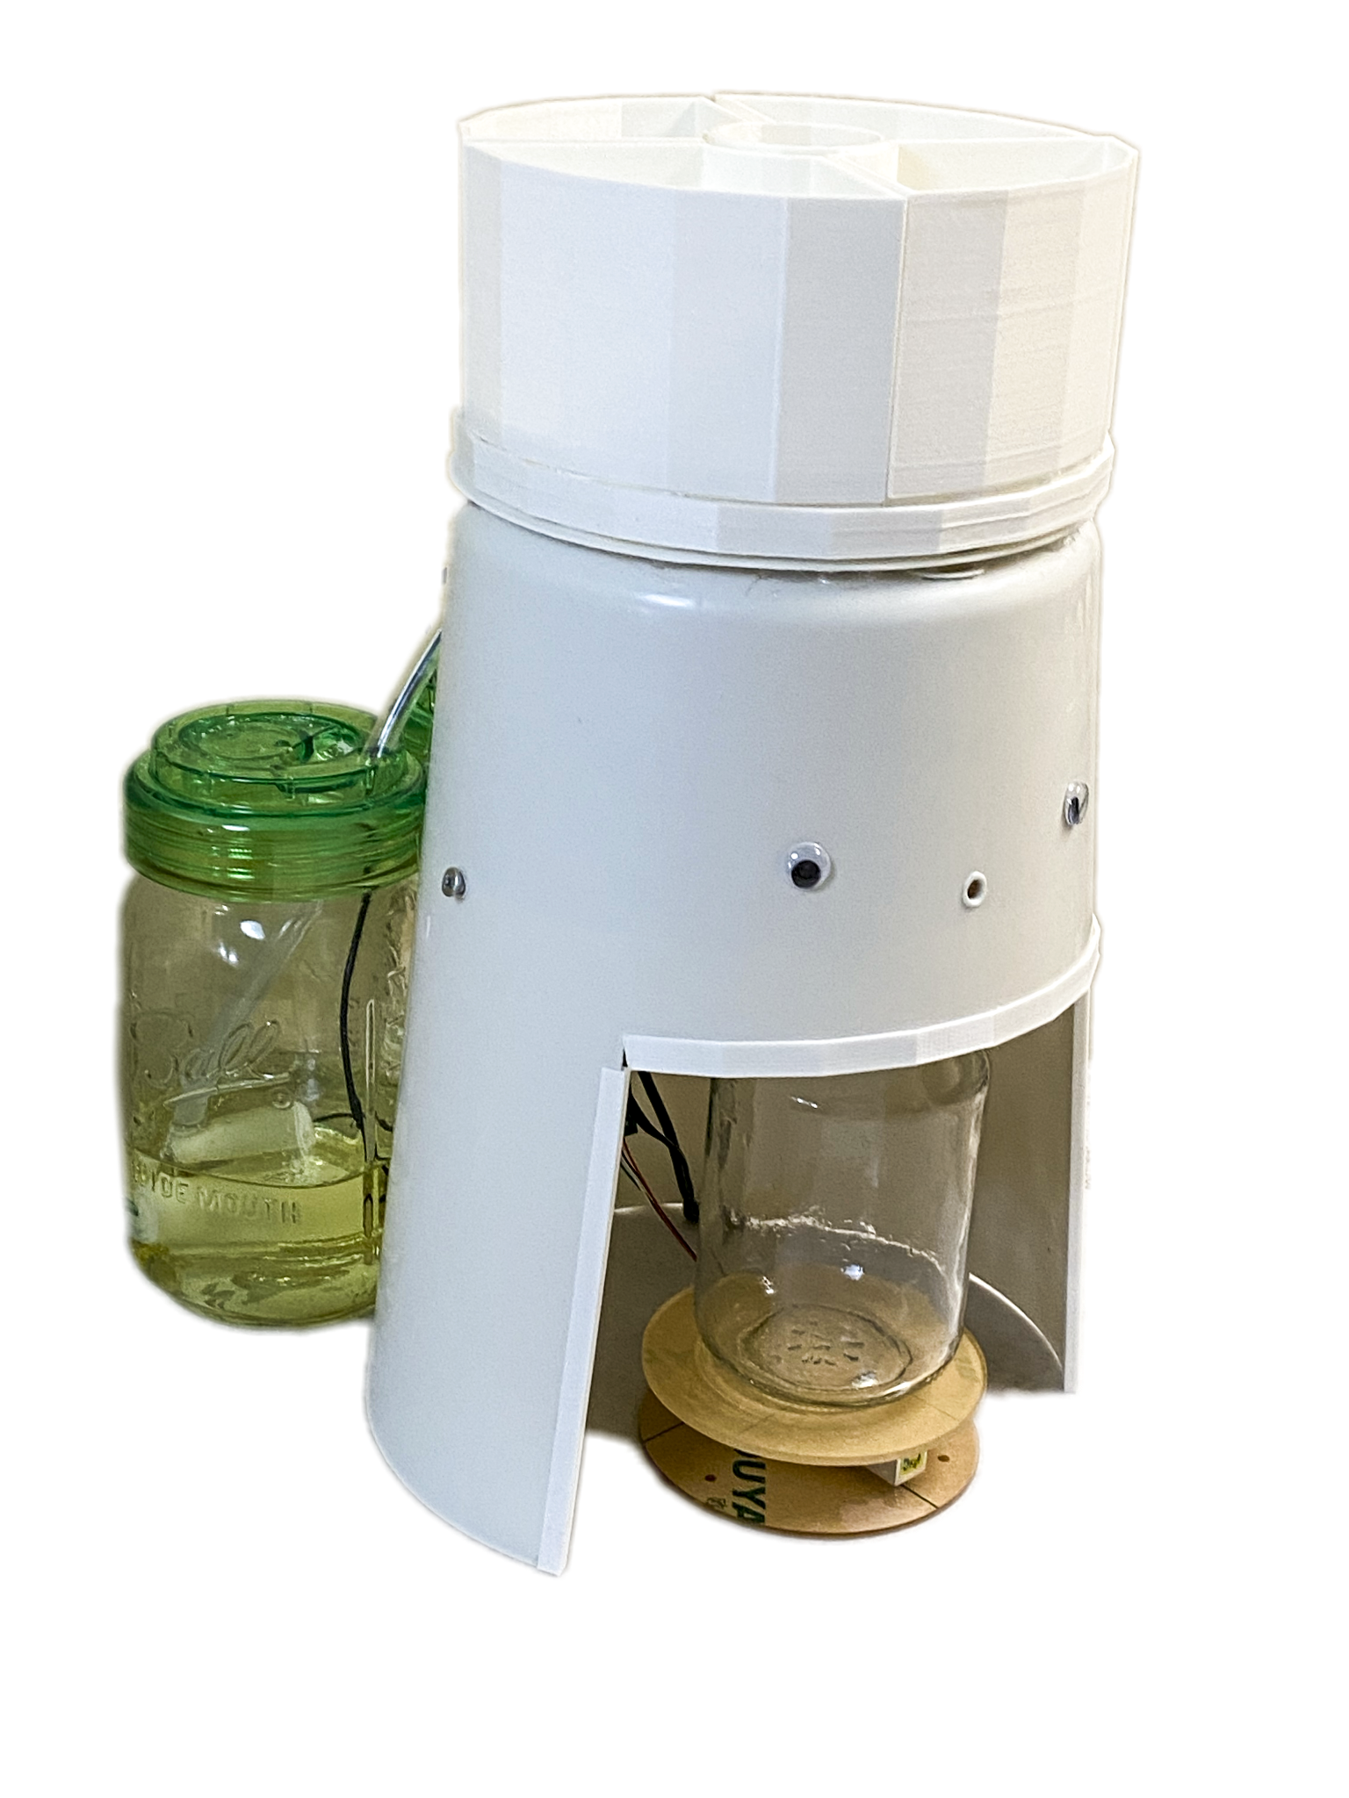
Final Design
Updated design to alleviate these problems
Raspberry Pi controls components, dispensing a given ingredient and determining how much is dispensed.
Four compartments for solid ingredients, dispensed by a single servo.
Two containers with pumps for liquid ingredients allows load on top to be reduced, easier maintenance, and dispensing.
Scale on bottom calculates how much of a liquid or solid ingredient is dispensed.
Torque Required for a maximum payload of 25kg is about 7 Nm
Notes:
Cody
Solid only to reduce load on top
3cm * 245 N = ~7 Nm,

Slide 10
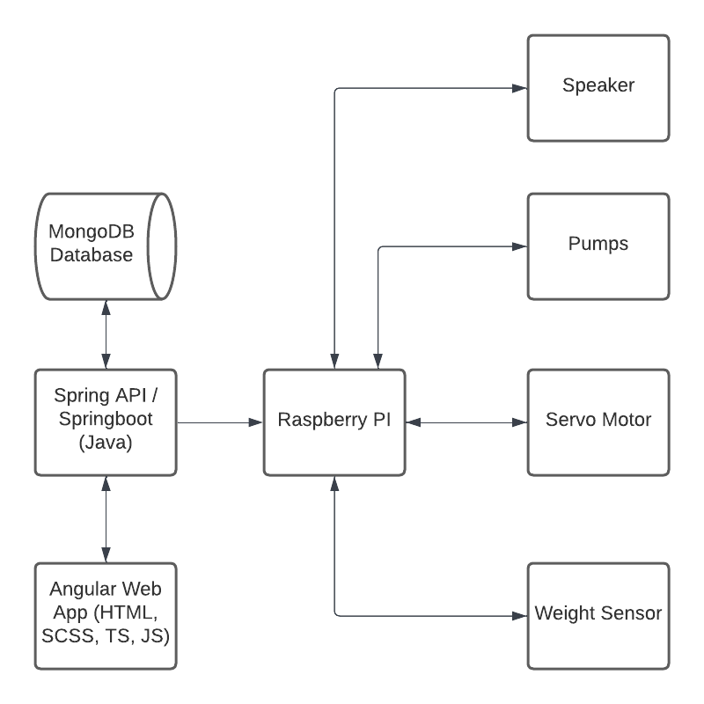
High-Level Design
Notes:
Nick

Slide 11
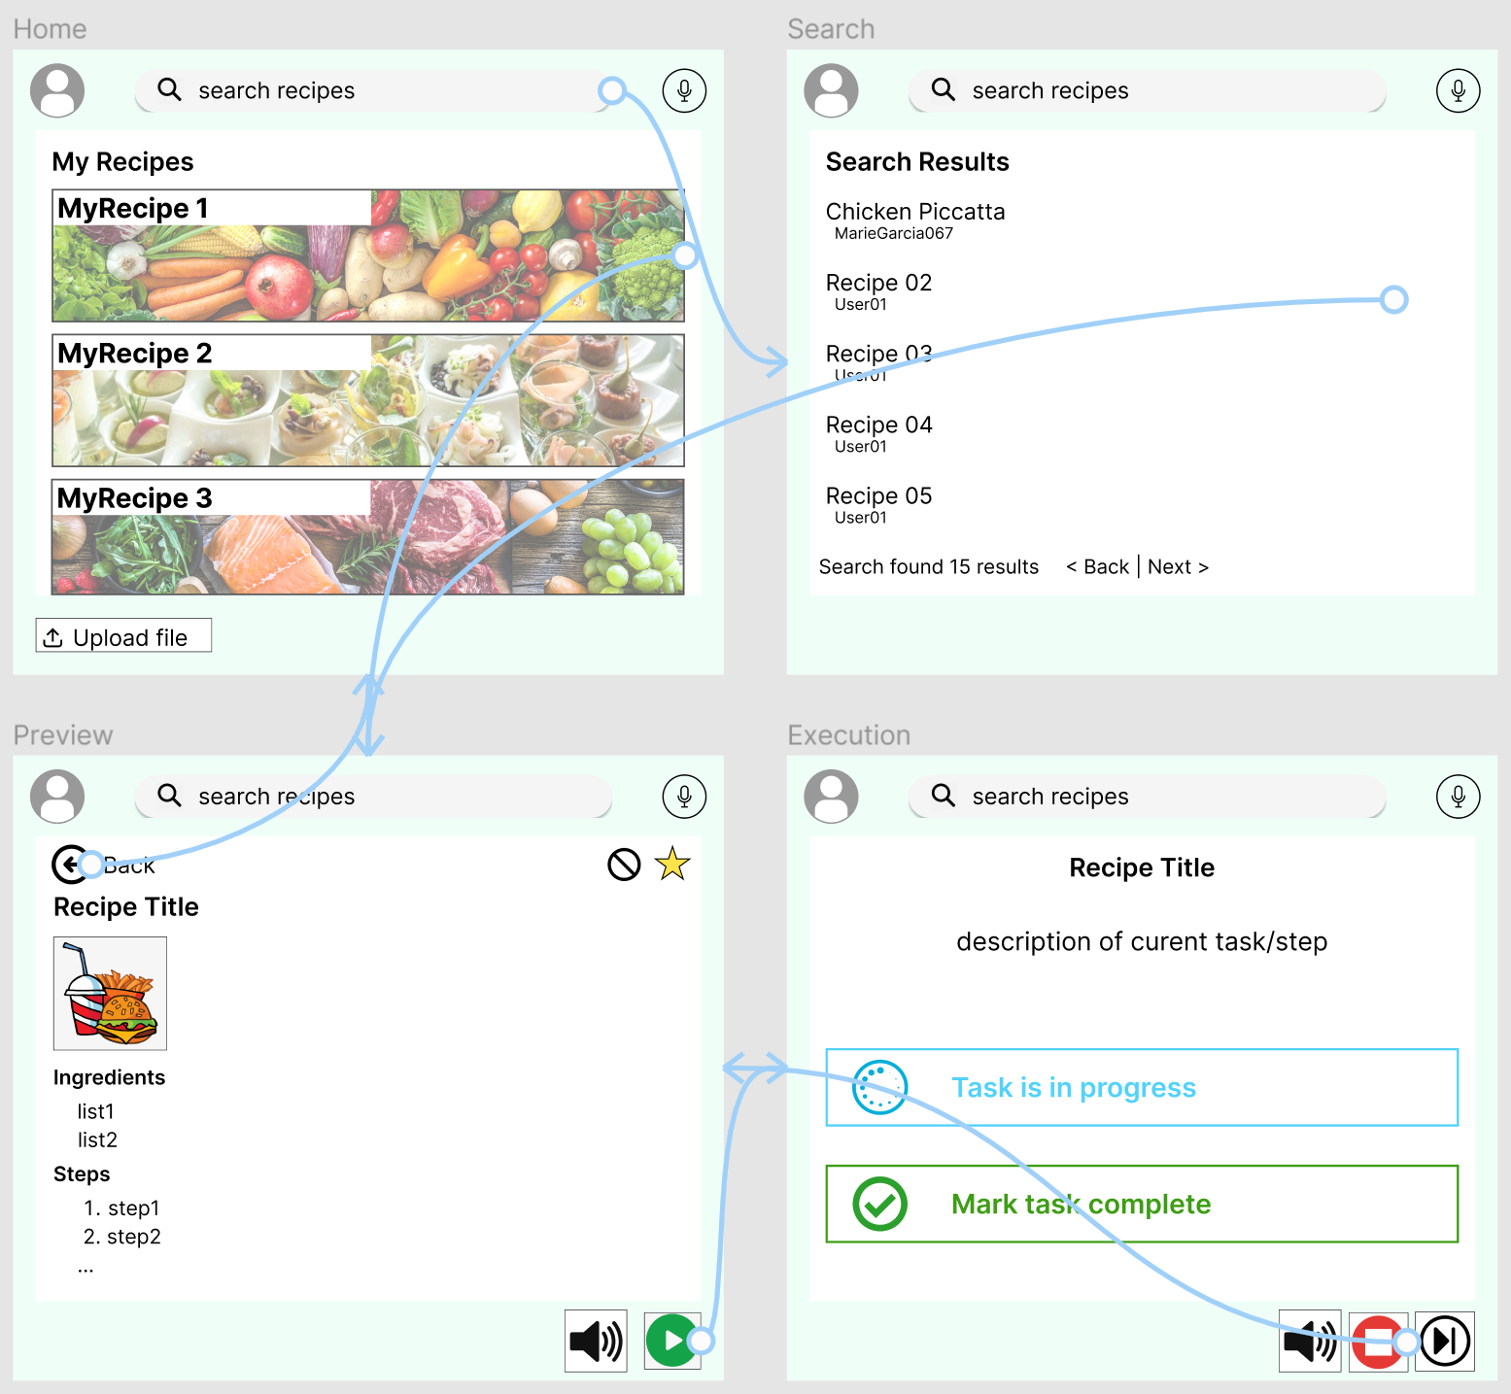
User Interface Design
To the right is the basic wireframe showing how the application interface is currently meant to work.
It is made to be easily adaptable if needed. Some functionality may later be added, modified, or subtracted.
Done via FIgma.
Notes:
Raney

Slide 12
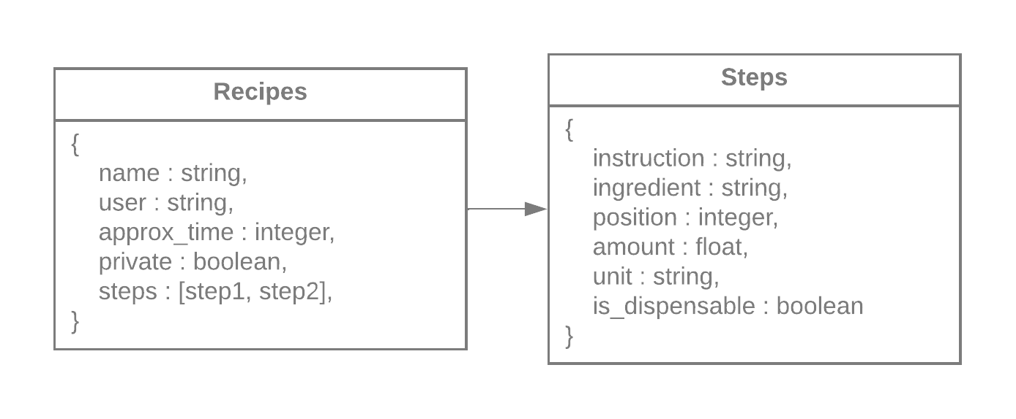
Database Design
Collections for the database
Json format (mongodb)
Can store many different recipes for multiple users
Scalable
Break down recipe into simple steps
One ingredient per step
Easy to communicate to the device
Notes:
Jake

Slide 13
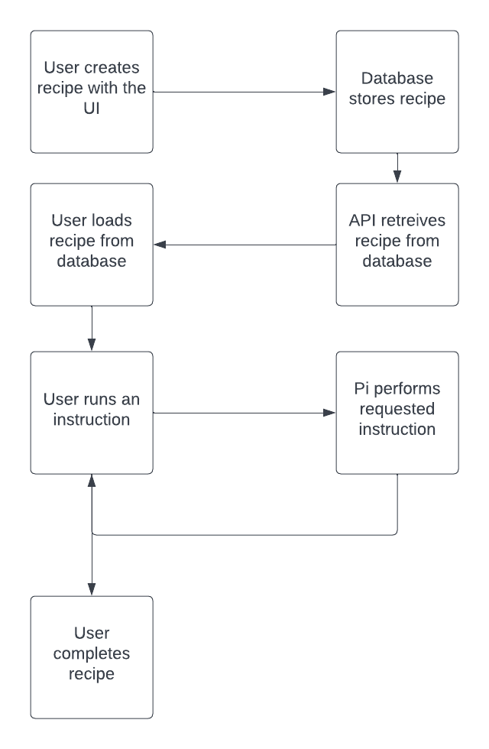
API
API created to interface with the database
UI updates database when user creates a recipe
UI uses GET requests to retrieve recipe from database as json
UI sends POST requests using the API to the raspberry pi to perform a dispense action
Notes:
Zach

Slide 14
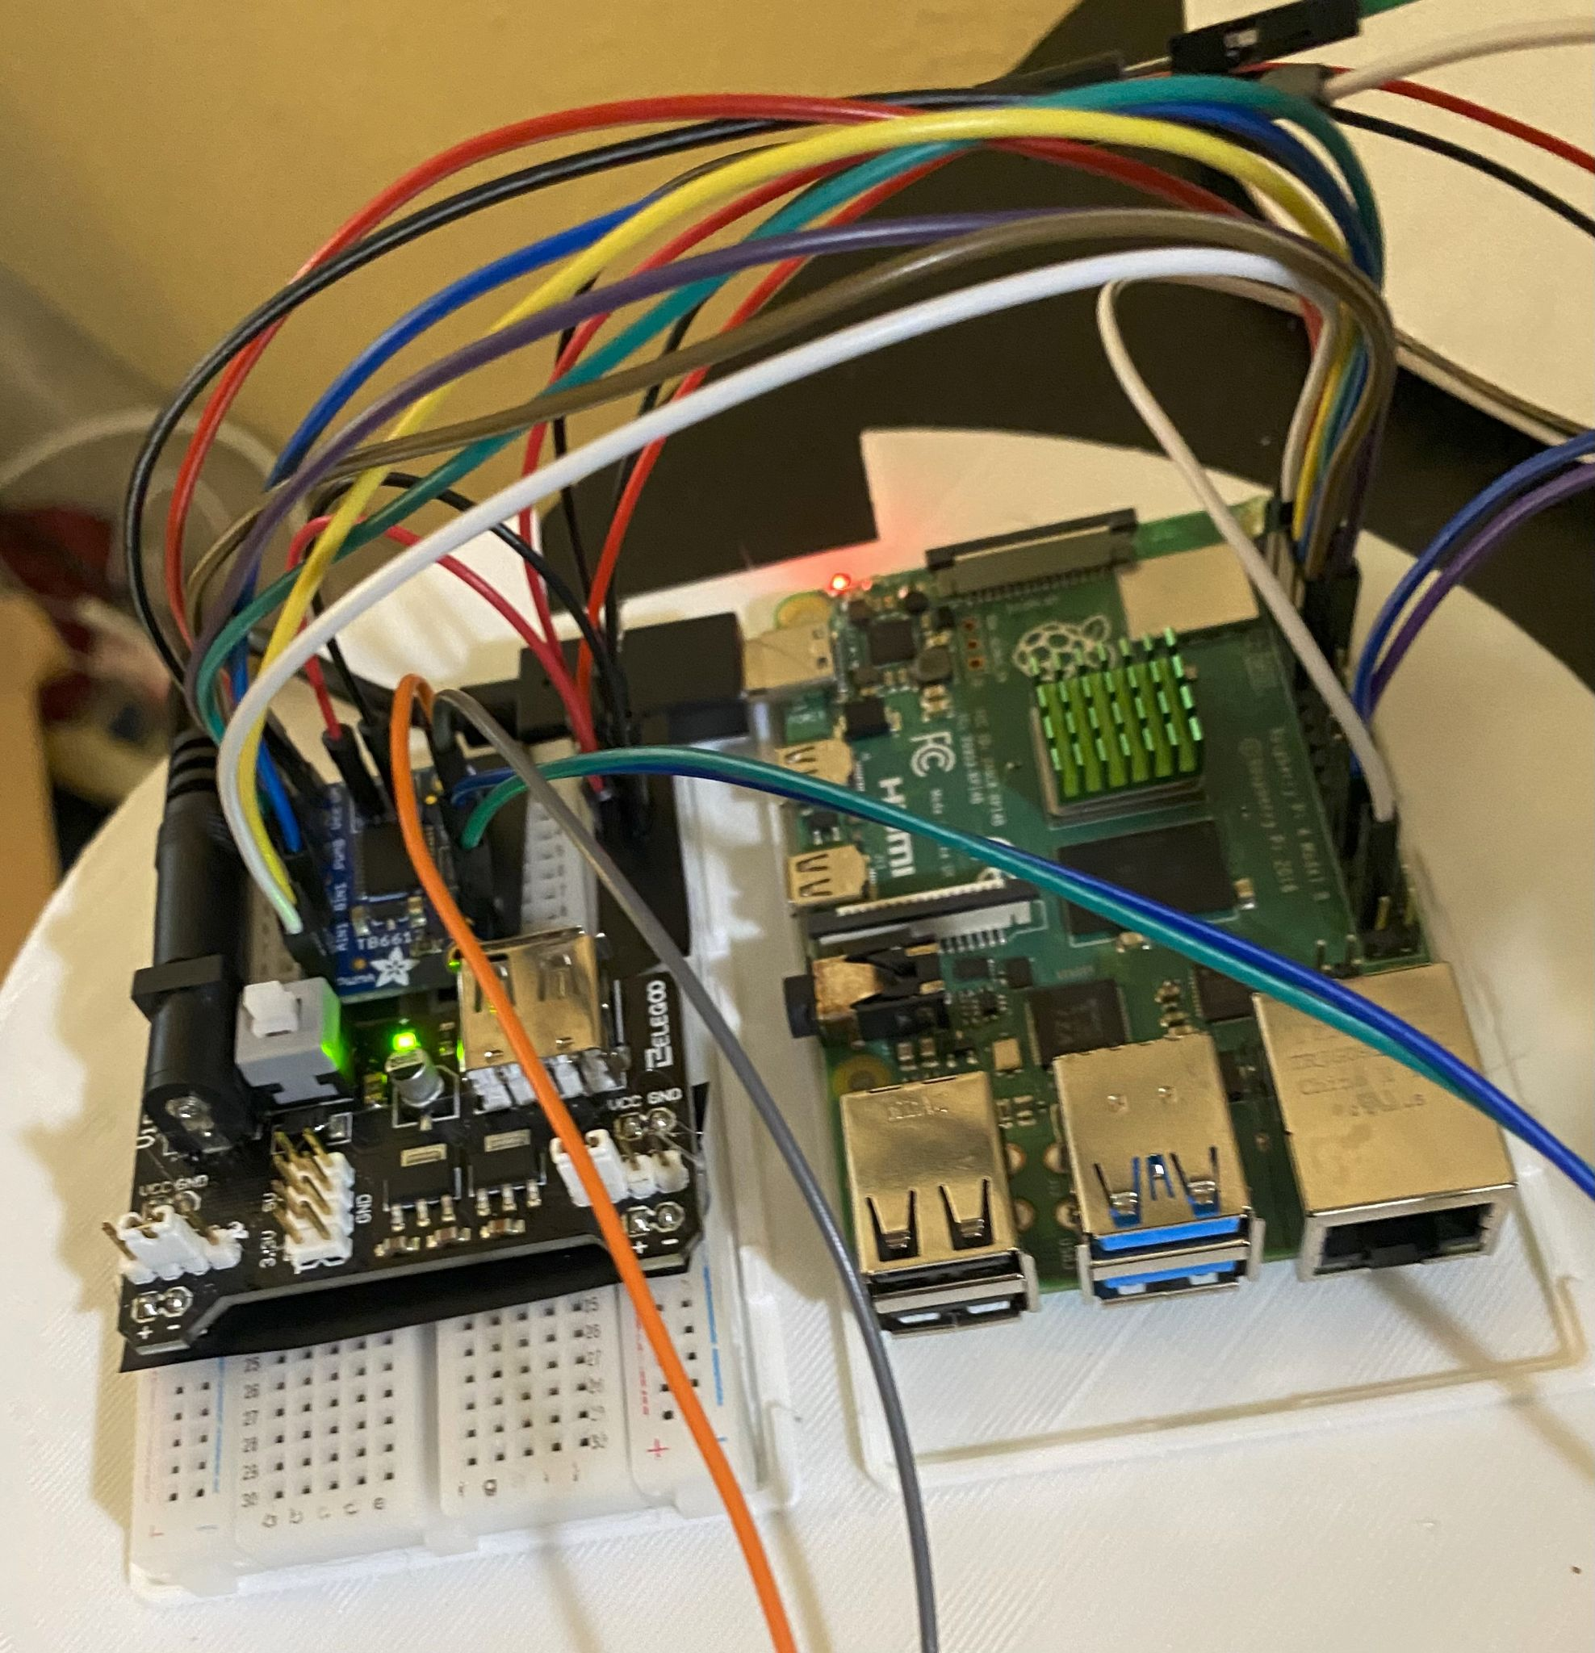
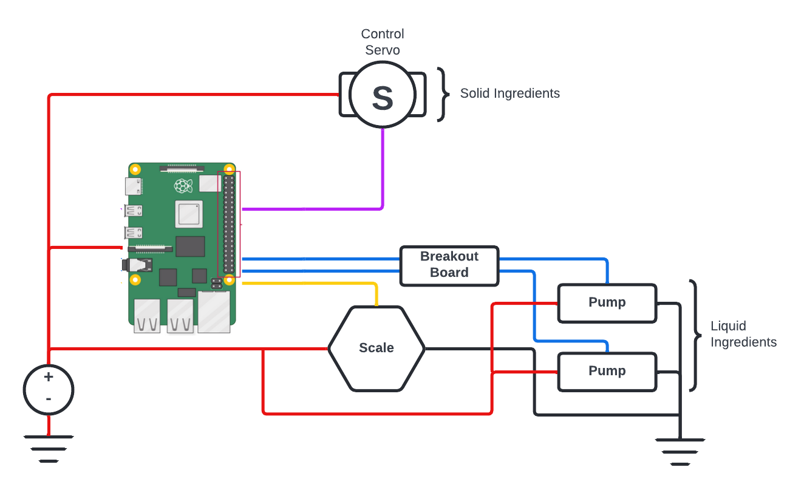
Electronics Design
Raspberry Pi 4 used as device controller
Input data received from server through HTTP requests
Each step the robot performs is inputted through a POST request with the necessary information
Data then compiled and individual motor/servo actions are performed until the given parameter is satisfied.
Notes:
Reid

Slide 15
Environmental and Health Concerns
Because of the food-centered focus of our robot, non-biodegradable materials are used for sanitary purposes
No disposable or one-time use components
Compartments that hold ingredients are removable and washable
More home cooking
Fresher ingredients
Ingredient selection for specific diets
Health improvement
Notes:
Nick

Slide 16
Manufacturability, Sustainability, and Economics
Majority of the product is currently 3D printed for prototyping purposes
In large scale production, this could be replaced with injection molded plastics
Database and server are scalable for a larger user base
With the current electronic components, production cost would be around $150 per unit
A dedicated server can cost anywhere from $100 - $200 a month (can upgrade/downgrade depending on current user amount)
Notes:
Reid

Slide 17
Social, Political, and Ethical Concerns
Data security:
Currently has a simple username function to differentiate user-made recipes
Can add password/email for user authentication
Database currently stores recipes (low-risk)
Private/public view option for recipes
No personal information used
Ethical concerns: if user posting a copyrighted recipe
Potential Social benefit: More diversity in dishes and diet
Notes:
Jake

Slide 18
Main Demonstration
Adding a recipe
Notes:
Cody & Raney/Zach?

Slide 19
Questions?
Comments?
Concerns?
Photo by Ella Olsson on Unsplash

